Slide 1
Analysing the Impact of Car Features on Price and Profitability
BY- AYUSH WABKHEDE

Slide 2
Problem Statement:
Over the last few decades, the automotive industry has experienced rapid change, with an increasing emphasis on technological innovation, environmental sustainability, and fuel efficiency. Understanding the elements that drive customer demand for cars is now more crucial than ever due to rising manufacturer competition and a changing consumer landscape.
Electric and hybrid vehicles have become more popular in recent years, and interest in alternative fuels like hydrogen and natural gas has also grown. However, traditional gasoline-powered vehicles continue to dominate the market, and consumers have access to a variety of fuel types and grades.
How can a car manufacturer optimize pricing and product development decisions to maximise profitability while fulfilling consumer demand is the question the client asked as a data analyst for the given dataset.
This issue could be solved by determining which features and market segments are the most well-liked by consumers and the most lucrative for the manufacturer by looking at the relationship between a car's characteristics, market category, and pricing. The company might create a pricing strategy that combines customer demand with profitability and select which product characteristics to concentrate on in subsequent product development efforts by employing data analysis techniques like regression analysis and market segmentation. In the long run, this might help the manufacturing become more profitable and raise its marketability.

Slide 3
Dataset Description:
The dataset contains information on various car models and their specifications, and is titled "Car Features and MSRP". It was collected and made available on Kaggle by Cooper Union, a private college located in New York City.
Here is a brief overview of the dataset:
• Number of observations: 11,159
• Number of variables: 16
• File type: CSV (Comma Separated Values)
The variables in the dataset are:
• Make: the make or brand of the car
• Model: the specific model of the car
• Year: the year the car was released
• Engine Fuel Type: the type of fuel used by the car (gasoline, diesel, etc.)
• Engine HP: the horsepower of the car's engine
• Engine Cylinders: the number of cylinders in the car's engine
• Transmission Type: the type of transmission (automatic or manual)
• Driven_Wheels: the type of wheels driven by the car (front, rear, all)
• Number of Doors: the number of doors the car has
• Market Category: the market category the car belongs to (Luxury, Performance, etc.)
• Vehicle Size: the size of the car

Slide 4
• Vehicle Style: the style of the car (Sedan, Coupe, etc.)
• Highway MPG: the estimated miles per gallon the car gets on the highway
• City MPG: the estimated miles per gallon the car gets in the city
• Popularity: a ranking of the popularity of the car (based on the number of times it has been viewed on Edmunds.com)
• MSRP: the manufacturer's suggested retail price of the car
This dataset could be useful for a variety of data analysis tasks, such as:
• Exploring trends in car features and pricing over time
• Comparing the fuel efficiency of different types of cars
• Investigating the relationship between a car's features and its popularity
• Predicting the price of a car based on its features and market category
However, it's important to note that the dataset was last updated in 2017, so it may not reflect current trends or prices in the automotive industry.

Slide 5
Approach:
Gather and clean data: Collect data on car features such as engine size, transmission type, fuel type, body style, etc. along with their prices and profitability. Clean the data to remove any errors, missing values, and outliers.
Explore and visualize data: Use descriptive statistics and visualization techniques such as histograms, scatter plots, and box plots to understand the distribution of data and identify any patterns, trends, or relationships between car features, prices, and profitability.
Conduct statistical analysis: Use statistical techniques such as regression analysis, correlation analysis, and hypothesis testing to quantify the impact of car features on prices and profitability. For example, you can use regression analysis to estimate the effect of engine size, transmission type, and other variables on car prices and profitability.
Interpret and communicate results: Interpret the results of your analysis and communicate them effectively to stakeholders. Provide insights on which car features are most important for determining prices and profitability and suggest strategies for improving profitability.
Iterate and refine analysis: Refine your analysis based on feedback from stakeholders, new data, or changes in the market. Continuously improve your analysis to provide more accurate and actionable insights.

Slide 6
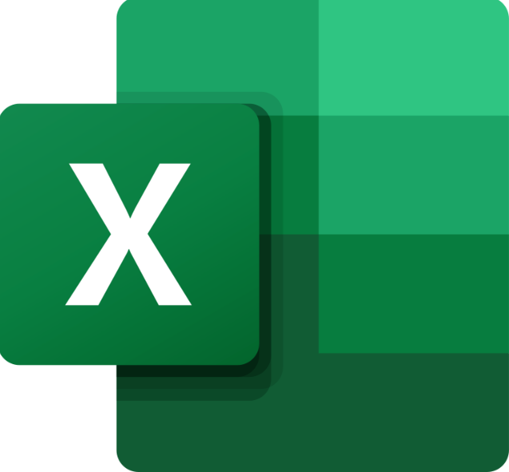


Tech-Stack Used:
Excel
PowerPoint
Google drive

Slide 7
Tasks: Analysis Before diving into the analysis of the given dataset, it is important to perform thorough data cleaning to ensure accurate and reliable results. You need to build an interactive dashboard in Excel from the tasks given below:
Telling us that the dimensions of ‘Car_data’, as(11915, 16)
Next, we calculate the null value percentage of each column in Excel using the formula =COUNTBLANK(A2:A307512)/COUNT(A2:A307512)*100 and then extending it to all 16 columns of the table.
I found that 4 of the columns contains Missing values so I use appropriate method to deal with it.

Slide 8
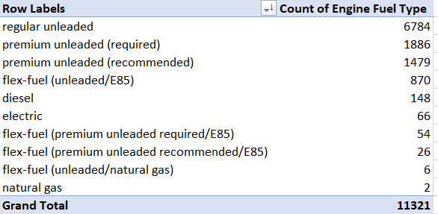
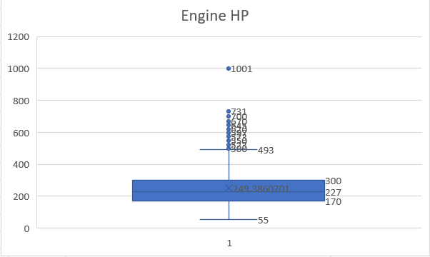
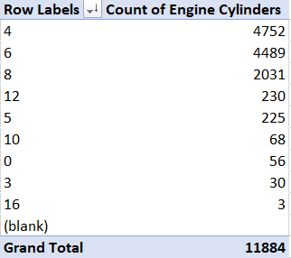
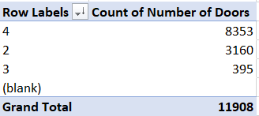
Engine Fuel Type
I used pivot table to analysis most occurrence Engine fuel so that I can fill the missing cell with the most Accurate value (regular unleaded)
Engine HP
I have plot the BOX AND WHSKER chart to analysis column and insert the missing value as the median(277)
Engine Cylinders
I used pivot table to analysis most occurrence Engine Cylinders so that I can fill the missing cell with the most Accurate value (4)
Number of Doors
I used pivot table to analysis most occurrence Number of Doors so that I can fill the missing cell with the most Accurate value (4)

Slide 9
Insight Required: How does the popularity of a car model vary across different market categories? Task 1.A: Create a pivot table that shows the number of car models in each market category and their corresponding popularity scores.
Insert a pivot table: In Excel, go to the "Insert" tab and click on "PivotTable". Choose the range of data that includes the car models, market categories, and popularity scores.
Set up the pivot table: In the "PivotTable Fields" pane, drag the market category field to the "Rows" section and the popularity score field to the "Values" section. This will show the total popularity score for each market category.
Add a count field: To add a count of the car models in each market category, drag the car model field to the "Values" section again. Excel will automatically add a count field, which shows the number of car models in each market category.
Format the pivot table: You can format the pivot table to make it more readable and informative. For example, you can add conditional formatting to highlight the highest and lowest popularity scores, or you can sort the rows by the count or popularity score.
The resulting pivot table will show the number of car models in each market category and their corresponding popularity scores. This can help to identify which market categories have the most popular car models and which ones may need more attention or marketing efforts.

Slide 10
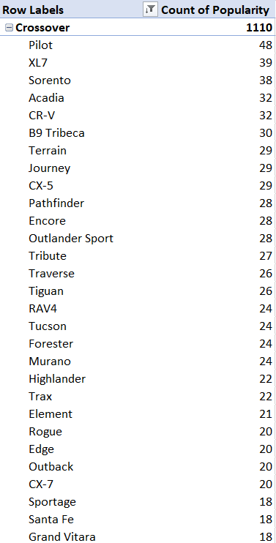
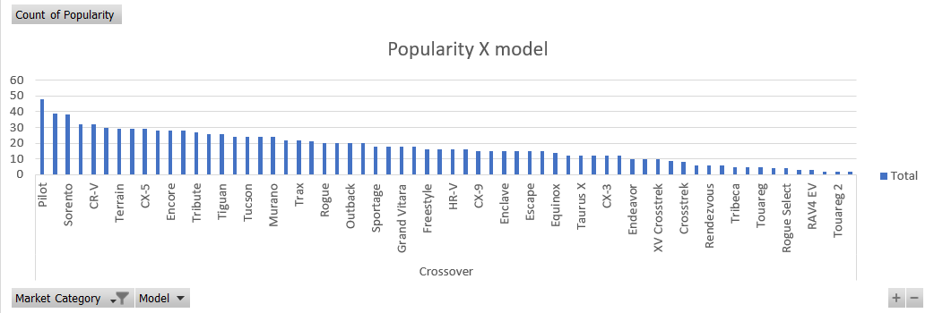
Pivot Table
For Crossover Market Categories there are 32 models among which “pilot”,”XL7”,”Sorento” are the top 3 model corresponding to there popularity scores. For analyse the pivot table easily I plot a bar graph .

Slide 11
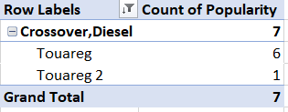


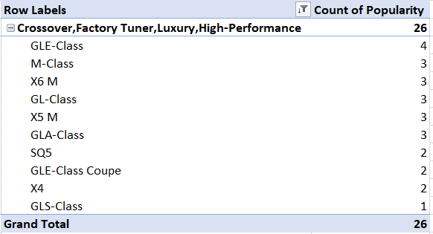
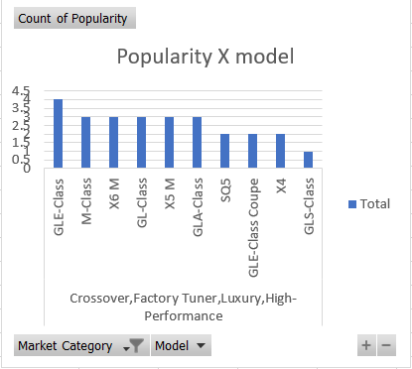
For (Crossover, Diesel) Market Categories Touareg is the most popular model corresponding to popularity scores.
For (Crossover, Exotic , Luxury, High-Performance) Market Categories Levante is the most popular model corresponding to popularity scores.
For (Crossover, Exotic , Luxury, Performance) Market Categories Levante is the most popular model corresponding to popularity scores.
For (Crossover, Factory , Tuner, Luxury, High-Performance) Market Categories GLE-Class is the most popular model corresponding to popularity scores.

Slide 12
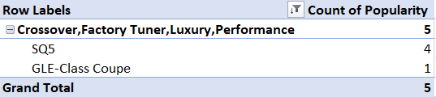

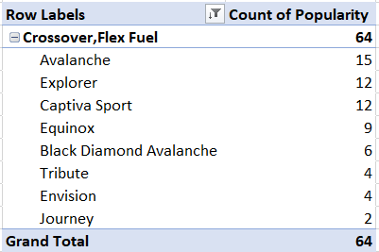
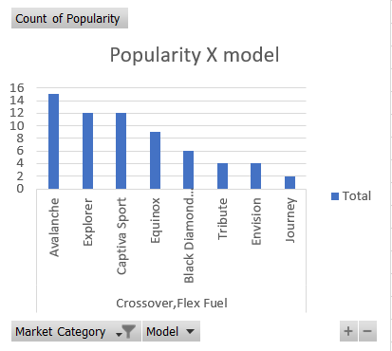
For (Crossover, Factory Tuner , Luxury , Performance) Market Categories SQ5 is the most popular model corresponding to popularity scores.
For (Crossover, Factory Tuner, Performance) Market Categories Torrent is the most popular model corresponding to popularity scores.
For (Crossover, Flex , fuel) Market Categories Avalanche is the most popular model corresponding to popularity scores.

Slide 13
 | Crossover,Flex Fuel,Luxury | 10
 | 130 | 5
 | 1624 | 3
 | 3105 | 2
 | Crossover,Flex Fuel,Luxury,Performance | 6
 | 1624 | 6
 | Crossover,Flex Fuel,Performance | 6
 | 5657 | 6
 | Crossover,Hatchback | 72
 | 481 | 20
 | 2009 | 18
 | 2202 | 34
 | Crossover,Hatchback,Factory Tuner,Performance | 6
 | 2009 | 6
 | Crossover,Hatchback,Luxury | 7
 | 204 | 7
 | Crossover,Hatchback,Performance | 6
 | 2009 | 6
 | Crossover,Hybrid | 42
 | 586 | 8
 | 640 | 6
 | 873 | 1
 | 2009 | 4
 | 2031 | 11
 | 5657 | 12
 | Crossover,Luxury | 410
 | 61 | 41
 | 130 | 2
 | 190 | 43
 | 204 | 58
 | 258 | 55
 | 376 | 5
 | 454 | 34
 | 617 | 29
 | 870 | 58
 | 1624 | 27
 | 1715 | 3
 | 3105 | 30
 | 3916 | 25
 | Crossover,Luxury,Diesel | 34
 | 617 | 13
 | 873 | 1
 | 1715 | 2
 | 3105 | 12
 | 3916 | 6
 | Crossover,Performance | 69
 | 586 | 4
 | 873 | 8
 | 1851 | 26
 | 2031 | 15
 | 5657 | 16
 | Diesel | 84
 | 549 | 8
 | 873 | 47
 | 1385 | 15
 | 5657 | 14
 | Diesel,Luxury | 51
 | 258 | 4
 | 617 | 17
 | 3105 | 16
 | 3916 | 14
 | Exotic,Factory Tuner,High-Performance | 21
 | 259 | 8
 | 1158 | 10
 | 2774 | 3
 | Exotic,Factory Tuner,Luxury,High-Performance | 52
 | 238 | 18
 | 520 | 17
 | 617 | 16
 | 3916 | 1
 | Exotic,Factory Tuner,Luxury,Performance | 3
 | 520 | 3
 | Exotic,Flex Fuel,Factory Tuner,Luxury,High-Performance | 13
 | 520 | 13
 | Exotic,Flex Fuel,Luxury,High-Performance | 11
 | 520 | 11
 | Crossover,Luxury,High-Performance | 9
 | 190 | 4
 | 1715 | 5
 | Crossover,Luxury,Hybrid | 24
 | 190 | 4
 | 454 | 18
 | 3105 | 2
 | Crossover,Luxury,Performance | 113
 | 61 | 3
 | 190 | 21
 | 454 | 1
 | 617 | 14
 | 870 | 38
 | 1715 | 12
 | 3105 | 11
 | 3916 | 13
 | Crossover,Luxury,Performance,Hybrid | 2
 | 3916 | 2

Slide 14
 | Exotic,Luxury,High-Performance | 79
 | 67 | 7
 | 86 | 4
 | 204 | 4
 | 238 | 38
 | 454 | 1
 | 520 | 18
 | 617 | 2
 | 1715 | 2
 | 3916 | 3
 | Exotic,Luxury,High-Performance,Hybrid | 1
 | 204 | 1
 | Exotic,Luxury,Performance | 36
 | 67 | 3
 | 86 | 22
 | 520 | 11
 | Exotic,Performance | 10
 | 1391 | 10
 | Factory Tuner,High-Performance | 106
 | 210 | 9
 | 436 | 1
 | 640 | 14
 | 1013 | 2
 | 1385 | 26
 | 1851 | 22
 | 2009 | 16
 | 2202 | 2
 | 5657 | 14
 | Factory Tuner,Luxury | 2
 | 617 | 2
 | Factory Tuner,Luxury,High-Performance | 215
 | 190 | 14
 | 258 | 2
 | 454 | 7
 | 617 | 54
 | 870 | 4
 | 1439 | 1
 | 1624 | 26
 | 1715 | 3
 | 3105 | 50
 | 3916 | 54
 | Factory Tuner,Luxury,Performance | 31
 | 190 | 3
 | 204 | 3
 | 617 | 9
 | 870 | 6
 | 3105 | 9
 | 3916 | 1
 | Factory Tuner,Performance | 92
 | 155 | 1
 | 210 | 3
 | 436 | 6
 | 549 | 3
 | 586 | 12
 | 819 | 3
 | 873 | 18
 | 1385 | 14
 | 1851 | 6
 | 2202 | 15
 | 5657 | 11
 | Flex Fuel | 872
 | 155 | 25
 | 210 | 3
 | 535 | 7
 | 549 | 145
 | 586 | 13
 | 873 | 7
 | 1013 | 46
 | 1385 | 235
 | 1851 | 105
 | 2009 | 32
 | 2031 | 65
 | 5657 | 189
 | Flex Fuel,Diesel | 16
 | 5657 | 16
 | Flex Fuel,Factory Tuner,Luxury,High-Performance | 1
 | 258 | 1
 | Flex Fuel,Hybrid | 2
 | 155 | 2
 | Flex Fuel,Luxury | 39
 | 61 | 8
 | 130 | 2
 | 258 | 6
 | 376 | 12
 | 1624 | 8
 | 3105 | 3
 | Flex Fuel,Luxury,High-Performance | 33
 | 258 | 18
 | 1624 | 15
 | Flex Fuel,Luxury,Performance | 28
 | 258 | 5
 | 1624 | 23
 | Flex Fuel,Performance | 87
 | 155 | 9
 | 549 | 16
 | 1013 | 8
 | 1385 | 38
 | 1851 | 4
 | 5657 | 12
 | Flex Fuel,Performance,Hybrid | 2
 | 155 | 2
 | Hatchback | 641
 | 105 | 36
 | 210 | 9
 | 436 | 51
 | 481 | 22
 | 535 | 23
 | 586 | 38
 | 640 | 30
 | 819 | 17
 | 873 | 107
 | 1385 | 69
 | 1439 | 66
 | 1720 | 14
 | 1851 | 26
 | 2009 | 29
 | 2031 | 46
 | 2202 | 28
 | 5657 | 30
 | Hatchback,Diesel | 14
 | 873 | 14

Slide 15
 | Hatchback,Factory Tuner,High-Performance | 13
 | 640 | 2
 | 873 | 10
 | 5657 | 1
 | Hatchback,Factory Tuner,Luxury,Performance | 9
 | 204 | 5
 | 376 | 2
 | 3105 | 2
 | Hatchback,Factory Tuner,Performance | 22
 | 210 | 3
 | 436 | 3
 | 586 | 3
 | 819 | 3
 | 1851 | 4
 | 5657 | 6
 | Hatchback,Flex Fuel | 7
 | 5657 | 7
 | Hatchback,Hybrid | 72
 | 2031 | 34
 | 2202 | 38
 | Hatchback,Luxury | 46
 | 204 | 12
 | 376 | 15
 | 617 | 3
 | 870 | 3
 | 3916 | 13
 | Hatchback,Luxury,Hybrid | 3
 | 454 | 3
 | Hatchback,Luxury,Performance | 38
 | 204 | 11
 | 376 | 8
 | 870 | 3
 | 1715 | 5
 | 3916 | 11
 | Hatchback,Performance | 252
 | 210 | 6
 | 436 | 7
 | 535 | 6
 | 586 | 11
 | 640 | 6
 | 873 | 161
 | 1013 | 3
 | 1385 | 3
 | 1439 | 20
 | 1720 | 7
 | 1851 | 3
 | 2009 | 4
 | 2031 | 8
 | 2202 | 4
 | 5657 | 3
 | High-Performance | 199
 | 210 | 5
 | 535 | 1
 | 1013 | 2
 | 1385 | 62
 | 1439 | 15
 | 1851 | 20
 | 2009 | 87
 | 5657 | 7
 | Hybrid | 123
 | 549 | 12
 | 873 | 10
 | 1013 | 1
 | 1385 | 21
 | 1439 | 8
 | 1720 | 8
 | 2009 | 3
 | 2031 | 30
 | 2202 | 14
 | Luxury | 855
 | 61 | 84
 | 130 | 8
 | 155 | 2
 | 190 | 88
 | 204 | 90
 | 258 | 32
 | 376 | 50
 | 454 | 51
 | 549 | 1
 | 617 | 81
 | 870 | 112
 | 873 | 2
 | 1013 | 2
 | 1439 | 1
 | 1624 | 74
 | 1720 | 2
 | 2031 | 3
 | 3105 | 130
 | 3916 | 42
 | Luxury,High-Performance | 334
 | 21 | 1
 | 113 | 5
 | 190 | 29
 | 258 | 15
 | 454 | 11
 | 617 | 48
 | 870 | 12
 | 1439 | 8
 | 1624 | 37
 | 1715 | 90
 | 1720 | 3
 | 3105 | 28
 | 3916 | 47
 | Luxury,High-Performance,Hybrid | 12
 | 190 | 6
 | 204 | 2
 | 454 | 3
 | 3916 | 1
 | Luxury,Hybrid | 52
 | 61 | 9
 | 190 | 6
 | 204 | 2
 | 454 | 9
 | 549 | 12
 | 1385 | 2
 | 1624 | 12
 | Luxury,Performance | 673
 | 21 | 2
 | 61 | 19
 | 190 | 111
 | 204 | 57
 | 258 | 5
 | 376 | 19
 | 454 | 61
 | 617 | 47
 | 870 | 45
 | 873 | 9
 | 1439 | 4
 | 1624 | 166
 | 1715 | 14
 | 3105 | 27
 | 3916 | 87
 | Luxury,Performance,Hybrid | 11
 | 190 | 1
 | 454 | 3
 | 617 | 1
 | 3916 | 6
 | Performance | 601
 | 26 | 3
 | 105 | 12
 | 155 | 26
 | 210 | 23
 | 436 | 4
 | 535 | 2
 | 549 | 10
 | 586 | 63
 | 640 | 44
 | 819 | 3
 | 873 | 145
 | 1013 | 32
 | 1385 | 33
 | 1439 | 21
 | 1720 | 19
 | 1851 | 29
 | 2009 | 34
 | 2031 | 30
 | 2202 | 32
 | 5657 | 36
 | Performance,Hybrid | 1
 | 155 | 1
 | Grand Total | 11914
 | N/A | 3742
 | 26 | 147
 | 105 | 12
 | 155 | 71
 | 210 | 109
 | 436 | 85
 | 481 | 252
 | 535 | 43
 | 549 | 245
 | 586 | 164
 | 640 | 42
 | 819 | 21
 | 873 | 224
 | 1013 | 79
 | 1385 | 501
 | 1439 | 89
 | 1720 | 122
 | 1851 | 306
 | 2009 | 240
 | 2031 | 443
 | 2202 | 165
 | 5657 | 382
 | Performance | 601
 | 26 | 3
 | 105 | 12
 | 155 | 26
 | 210 | 23
 | 436 | 4
 | 535 | 2
 | 549 | 10
 | 586 | 63
 | 640 | 44
 | 819 | 3
 | 873 | 145
 | 1013 | 32
 | 1385 | 33
 | 1439 | 21
 | 1720 | 19
 | 1851 | 29
 | 2009 | 34
 | 2031 | 30
 | 2202 | 32
 | 5657 | 36
 | Performance,Hybrid | 1
 | 155 | 1
 | Grand Total | 11914

Slide 16
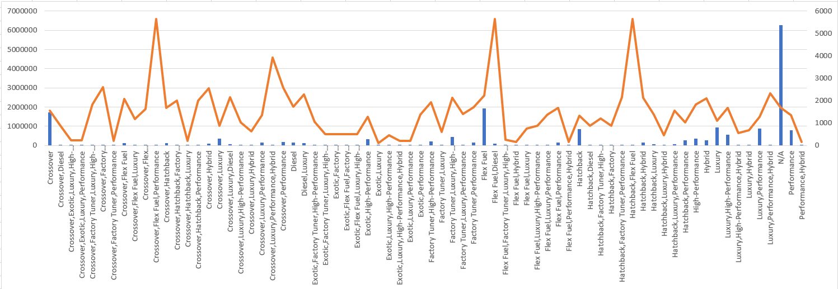
Task 1.B: Create a combo chart that visualizes the relationship between market category and popularity.

Slide 17
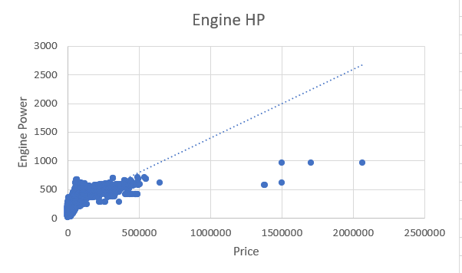
Insight Required: What is the relationship between a car's engine power and its price? Task 2: Create a scatter chart that plots engine power on the x-axis and price on the y-axis. Add a trendline to the chart to visualize the relationship between these variables.
Insert a scatter chart: In Excel, select the data range that includes the engine power and price data. Go to the "Insert" tab and click on "Scatter". Choose the "Scatter with Straight Lines and Markers" option.
Set up the chart: Right-click on any of the data points in the chart and select "Add Trendline". In the "Format Trendline" pane that appears, choose the type of trendline you want to add, such as a linear trendline. You can also choose to display the equation and R-squared value on the chart.
Format the chart: You can format the chart to make it more readable and informative. For example, you can add axis labels and titles, adjust the scale of the axes, and change the color
of the data points and trendline.
Interpret the chart: The resulting scatter chart with a trendline will
show how the engine power and price are related. The trendline
represents the general direction and strength of the relationship,
and the equation and R-squared value can provide more
information about the slope and goodness of fit of the trendline.
Insight : Overall, a scatter chart with a trendline can help you identify
patterns and trends in the data and make informed decisions about pricing
And product development based on the relationship between engine power
and price.

Slide 18
Insight Required: Which car features are most important in determining a car's price? Task 3: Use regression analysis to identify the variables that have the strongest relationship with a car's price. Then create a bar chart that shows the coefficient values for each variable to visualize their relative importance.
Perform regression analysis: In Excel, select the data range that includes the car's price and the predictor variables. Go to the "Data" tab and click on "Data Analysis". Choose "Regression" from the list of analysis tools and follow the prompts to set up the regression analysis. Make sure to select the car's price as the dependent variable and the predictor variables as the independent variables.
Review the results: After running the regression analysis, review the results to identify the variables that have the strongest relationship with the car's price. Look at the coefficient values and their corresponding p-values to determine which variables are statistically significant predictors of the car's price.
Create a bar chart: Create a bar chart that shows the coefficient values for each variable to visualize their relative importance. In Excel, select the cells that contain the coefficient values and create a new bar chart. Format the chart to make it more readable and informative. For example, you can add axis labels and titles, adjust the color and width of the bars, and include the corresponding p-values as data labels.
Interpret the results: The resulting bar chart will show the coefficient values for each predictor variable and their relative importance in predicting the car's price. This can help you identify which variables have the strongest relationship with the price and make informed decisions about pricing and product development.

Slide 19
Regression Analysis of different Car Features
SUMMARY OUTPUT |  | Engine HP
Regression Statistics
Multiple R | 0.661721
R Square | 0.437875
Adjusted R Square | 0.437828
Standard Error | 45068.7
Observations | 11914
ANOVA
 | df | SS | MS | F | Significance F
Regression | 1 | 1.88E+13 | 1.88E+13 | 9279.01 | 0
Residual | 11912 | 2.42E+13 | 2.03E+09
Total | 11913 | 4.3E+13
 | Coefficients | Standard Error | t Stat | P-value | Lower 95% | Upper 95% | Lower 95.0% | Upper 95.0%
Intercept | -50555.2 | 1032.413 | -48.968 | 0 | -52578.9 | -48531.5 | -52578.9 | -48531.5
Engine HP | 365.2632 | 3.791884 | 96.32762 | 0 | 357.8305 | 372.6959 | 357.8305 | 372.6959
SUMMARY OUTPUT |  | Engine Cylinder
Regression Statistics
Multiple R | 0.531171
R Square | 0.282142
Adjusted R Square | 0.282082
Standard Error | 50930.46
Observations | 11914
ANOVA
 | df | SS | MS | F | Significance F
Regression | 1 | 1.21E+13 | 1.21E+13 | 4681.82 | 0
Residual | 11912 | 3.09E+13 | 2.59E+09
Total | 11913 | 4.3E+13
 | Coefficients | Standard Error | t Stat | P-value | Lower 95% | Upper 95% | Lower 95.0% | Upper 95.0%
Intercept | -60286.4 | 1546.43 | -38.9842 | 0 | -63317.6 | -57255.1 | -63317.6 | -57255.1
Engine Cylinders | 17935.29 | 262.1205 | 68.42382 | 0 | 17421.49 | 18449.09 | 17421.49 | 18449.09

Slide 20
SUMMARY OUTPUT |  | Number of doors
Regression Statistics
Multiple R | 0.126081
R Square | 0.015897
Adjusted R Square | 0.015814
Standard Error | 59631.93
Observations | 11914
ANOVA
 | df | SS | MS | F | Significance F
Regression | 1 | 6.84E+11 | 6.84E+11 | 192.4181 | 2.05E-43
Residual | 11912 | 4.24E+13 | 3.56E+09
Total | 11913 | 4.3E+13
 | Coefficients | Standard Error | t Stat | P-value | Lower 95% | Upper 95% | Lower 95.0% | Upper 95.0%
Intercept | 70149.36 | 2199.531 | 31.89287 | 2.9E-214 | 65837.92 | 74460.8 | 65837.92 | 74460.8
Number of Doors | -8600.52 | 620.0141 | -13.8715 | 2.05E-43 | -9815.85 | -7385.19 | -9815.85 | -7385.19
SUMMARY OUTPUT |  | highway MPG
Regression Statistics
Multiple R | 0.160043
R Square | 0.025614
Adjusted R Square | 0.025532
Standard Error | 59336.79
Observations | 11914
ANOVA
 | df | SS | MS | F | Significance F
Regression | 1 | 1.1E+12 | 1.1E+12 | 313.1303 | 3.48E-69
Residual | 11912 | 4.19E+13 | 3.52E+09
Total | 11913 | 4.3E+13
 | Coefficients | Standard Error | t Stat | P-value | Lower 95% | Upper 95% | Lower 95.0% | Upper 95.0%
Intercept | 69507.43 | 1721.963 | 40.36522 | 0 | 66132.1 | 72882.76 | 66132.1 | 72882.76
highway MPG | -1085.41 | 61.33844 | -17.6955 | 3.48E-69 | -1205.65 | -965.18 | -1205.65 | -965.18

Slide 21
SUMMARY OUTPUT |  | Popularity
Regression Statistics
Multiple R | 0.048476
R Square | 0.00235
Adjusted R Square | 0.002266
Standard Error | 60040.96
Observations | 11914
ANOVA
 | df | SS | MS | F | Significance F
Regression | 1 | 1.01E+11 | 1.01E+11 | 28.05848 | 1.2E-07
Residual | 11912 | 4.29E+13 | 3.6E+09
Total | 11913 | 4.3E+13
 | Coefficients | Standard Error | t Stat | P-value | Lower 95% | Upper 95% | Lower 95.0% | Upper 95.0%
Intercept | 43737.08 | 809.0096 | 54.0625 | 0 | 42151.29 | 45322.87 | 42151.29 | 45322.87
Popularity | -2.02091 | 0.381518 | -5.29703 | 1.2E-07 | -2.76875 | -1.27307 | -2.76875 | -1.27307
SUMMARY OUTPUT |  | city mpg
Regression Statistics
Multiple R | 0.157676
R Square | 0.024862
Adjusted R Square | 0.02478
Standard Error | 59359.69
Observations | 11914
ANOVA
 | df | SS | MS | F | Significance F
Regression | 1 | 1.07E+12 | 1.07E+12 | 303.7023 | 3.49E-67
Residual | 11912 | 4.2E+13 | 3.52E+09
Total | 11913 | 4.3E+13
 | Coefficients | Standard Error | t Stat | P-value | Lower 95% | Upper 95% | Lower 95.0% | Upper 95.0%
Intercept | 61403.7 | 1312.072 | 46.79905 | 0 | 58831.83 | 63975.58 | 58831.83 | 63975.58
city mpg | -1054.51 | 60.51008 | -17.4271 | 3.49E-67 | -1173.12 | -935.903 | -1173.12 | -935.903

Slide 22
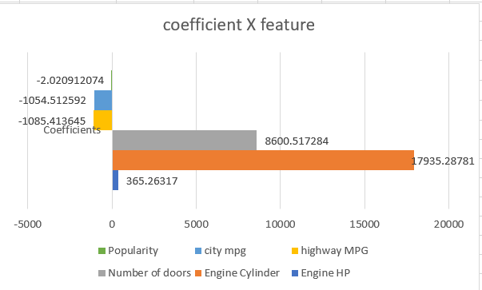
Bar chart that shows the coefficient values for each Features
From the above graph we can analyse that the ENGINE CYLINDER car features plays most important role in determining a car's price
Insight :Overall, using regression analysis and a bar chart to identify the variables that have the strongest relationship with a car's price can provide valuable insights into the factors that influence pricing and help you make data-driven decisions.

Slide 23
Insight Required: How does the average price of a car vary across different manufacturers? Task 4.A: Create a pivot table that shows the average price of cars for each manufacturer.
Insert a pivot table: In Excel, select the data range that includes the car manufacturer and price data. Go to the "Insert" tab and click on "PivotTable". Choose the range of data you want to analyze and where you want to place the pivot table.
Set up the pivot table: In the pivot table field list, drag the "Manufacturer" field to the "Rows" section and the "Price" field to the "Values" section. Make sure that the "Price" field is set to show the average value.
Analyze the results The resulting pivot table will show the average price of cars for each manufacturer. You can sort the data by price to identify the manufacturers with the highest and lowest average prices, and compare the prices across different manufacturers.
Interpret the results: By analyzing the pivot table, you can see how the average price of a car varies across different manufacturers. This information can help you make informed decisions about pricing and product development, as well as identify potential opportunities and challenges in the market.

Slide 24
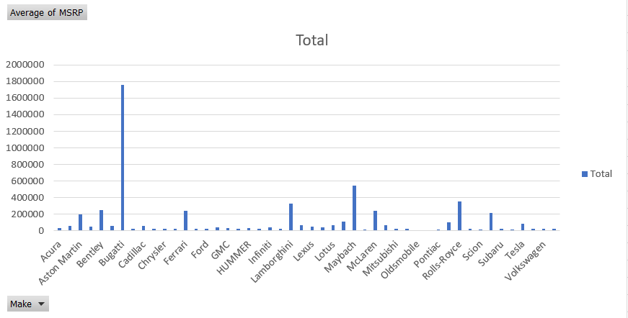
Row Labels | Average of MSRP
Acura | 34887.5873
Alfa Romeo | 61600
Aston Martin | 197910.3763
Audi | 53452.1128
Bentley | 247169.3243
BMW | 61546.76347
Bugatti | 1757223.667
Buick | 28206.61224
Cadillac | 56231.31738
Chevrolet | 28350.38557
Chrysler | 26722.96257
Dodge | 22390.05911
Ferrari | 238218.8406
FIAT | 22670.24194
Ford | 27399.26674
Genesis | 46616.66667
GMC | 30493.29903
Honda | 26674.34076
HUMMER | 36464.41176
Hyundai | 24597.0363
Infiniti | 42394.21212
Kia | 25310.17316
Lamborghini | 331567.3077
Land Rover | 67823.21678
Lexus | 47549.06931
Lincoln | 42839.82927
Lotus | 69188.27586
Maserati | 114207.7069
Maybach | 546221.875
Mazda | 20039.38298
McLaren | 239805
Mercedes-Benz | 71476.22946
Mitsubishi | 21240.53521
Nissan | 28583.4319
Oldsmobile | 11542.54
Plymouth | 3122.902439
Pontiac | 19321.54839
Porsche | 101622.3971
Rolls-Royce | 351130.6452
Saab | 27413.5045
Scion | 19932.5
Spyker | 213323.3333
Subaru | 24827.50391
Suzuki | 17907.20798
Tesla | 85255.55556
Toyota | 29030.01609
Volkswagen | 28102.38072
Volvo | 28541.16014
Grand Total | 40594.73703
Insight :Overall, creating a pivot table to analyze the average price of cars for each manufacturer can provide valuable insights into the pricing strategies and market positioning of different manufacturers.

Slide 25
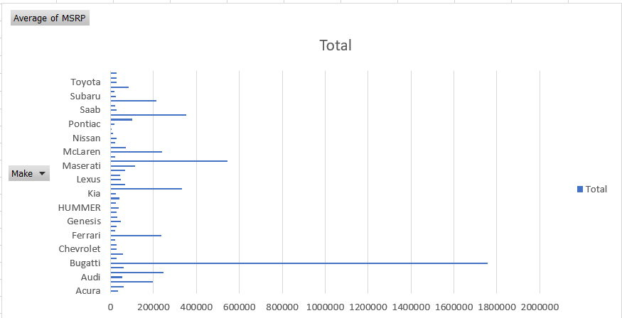
Task 4.B: Create a bar chart or a horizontal stacked bar chart that visualizes the relationship between manufacturer and average price.
Insert a bar chart: In Excel, select the pivot table and go to the "Insert" tab. Click on "Bar Chart" and select the type of chart you want to create. For this analysis, a horizontal stacked bar chart may be useful to show the average price of each manufacturer and compare them.
Interpret the results: The resulting bar chart will show the average price of cars for each manufacturer and help you identify which manufacturers have the highest and lowest average prices. You can use this information to compare pricing strategies across different manufacturers and make informed decisions about pricing and product development.
Overall, creating a bar chart to visualize the relationship between manufacturer and average price can provide valuable insights into the pricing strategies and market positioning of different manufacturers, and help you make data-driven decisions.

Slide 26
Insight Required: What is the relationship between fuel efficiency and the number of cylinders in a car's engine? Task 5.A: Create a scatter plot with the number of cylinders on the x-axis and highway MPG on the y-axis. Then create a trendline on the scatter plot to visually estimate the slope of the relationship and assess its significance.
Insert a scatter plot: In Excel, select the data range that includes the number of cylinders and highway MPG data. Go to the "Insert" tab and click on "Scatter Plot". Choose the type of scatter plot you want to create, such as a basic scatter plot or a scatter plot with markers.
Add axis labels: Add axis labels to the scatter plot by right-clicking on the chart and selecting "Add Chart Element" > "Axis Titles". Enter the labels for the x-axis and y-axis.
Add a trendline: Add a trendline to the scatter plot by right-clicking on one of the data points and selecting "Add Trendline". Choose the type of trendline you want to add, such as a linear trendline or a logarithmic trendline.
Analyze the trendline: The resulting scatter plot with the trendline will visually estimate the slope of the relationship between the number of cylinders and highway MPG, and show how strong the
relationship is. You can use the R-squared value, which is displayed in the
trendline options, to assess the significance of the relationship. An
R-squared value of 1 indicates a perfect correlation, while a value of 0
indicates no correlation.
Insight : Overall, creating a scatter plot with a trendline can help you
visualize the relationship between two variables and assess its significance.
This information can be useful in identifying patterns and making informed
decisions about product development and marketing.

Slide 27
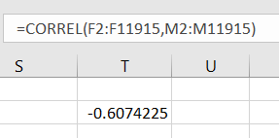
Task 5.B: Calculate the correlation coefficient between the number of cylinders and highway MPG to quantify the strength and direction of the relationship.
Calculate the correlation coefficient: In Excel, use the "CORREL" function to calculate the correlation coefficient between the two variables. Enter the formula
"=CORREL(A1:A10,B1:B10)"
(assuming the number of cylinders is in column A and highway MPG is in column B)
and press "Enter". Excel will calculate the correlation coefficient
and display the result in the cell.
Interpret the results: The resulting correlation coefficient will be a value between
-1 and 1, with a negative value indicating a negative correlation (as one variable
increases, the other decreases), a positive value indicating a positive correlation (as one variable increases, the other increases), and a value of 0 indicating no correlation. The closer the value is to -1 or 1, the stronger the correlation.
AS the correlation coefficient between the number of cylinders and highway MPG is -0.6074225, this would indicate a strong negative correlation between the two variables. This means that as the number of cylinders increases, highway MPG decreases.
Overall, calculating the correlation coefficient between two variables can help you quantify the strength and direction of the relationship between them, and make informed decisions about product development and marketing based on this information.

Slide 28
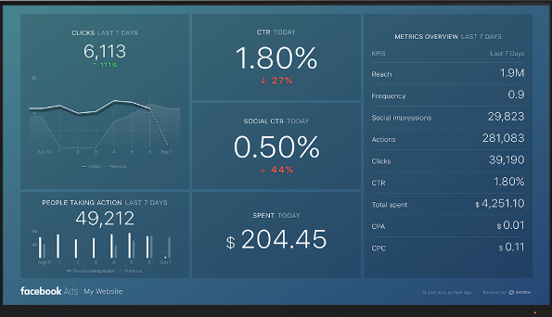
Building the Dashboard: Now for the Next portion of the Project, you need to create the Interactive Dashboard. Use filters and slicers to make the chart interactive. The client has requested these questions given below:

Slide 29
Task 1: How does the distribution of car prices vary by brand and body style? Hints: Stacked column chart to show the distribution of car prices by brand and body style. Use filters and slicers to make the chart interactive. Calculate the total MSRP for each brand and body style using SUMIF or Pivot Tables.
Calculate the total MSRP for each brand and body style: Use the SUMIF function or Pivot Tables to calculate the total MSRP for each brand and body style.
Create a Pivot Table with the brand and body style as rows, and the MSRP as values, with the function set to "Sum". This will give you the total MSRP for each brand and body style.
Create a stacked column chart: Create a stacked column chart to show the distribution of car prices by brand and body style. Use the total MSRP for each brand and body style as the values, and the brand and body style as the categories.
Add filters and slicers: Add filters and slicers to make the chart interactive, allowing users to filter by brand and body style. This will help users to quickly identify the distribution of car prices for a particular brand or body style.
Format the chart: Format the chart to make it visually appealing and easy to understand. Add labels, titles, and legends to make it easy for users to interpret the data.
Add the chart to the dashboard: Add the chart to the dashboard and adjust the size and position as necessary. You can also add other relevant charts and visualizations to the dashboard to provide a comprehensive view of the data.

Slide 30
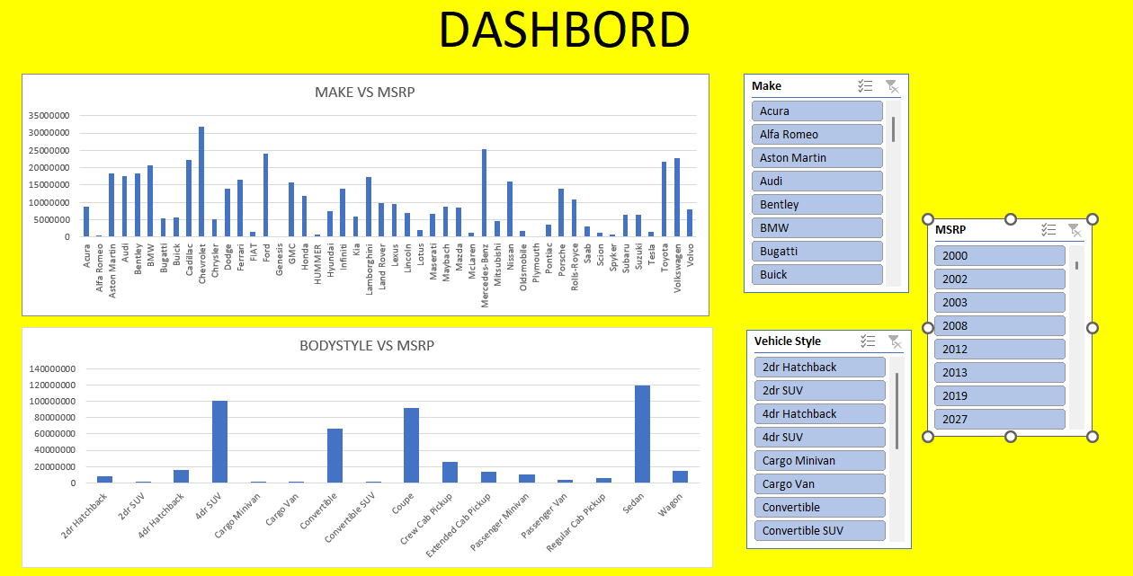

Slide 31
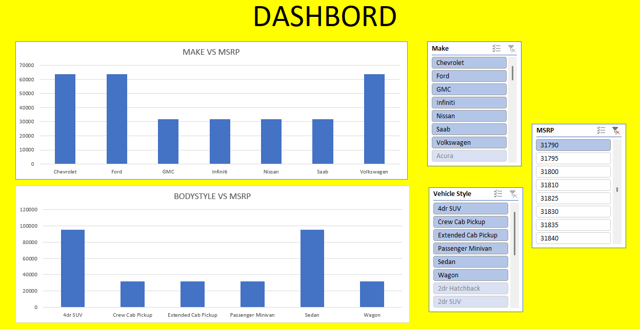
Overall, this dashboard can help users to quickly identify the distribution of car prices by brand and body style, and can inform pricing and marketing strategies. The interactivity provided by filters and slicers makes it easy for users to explore the data and gain insights.

Slide 32
Task 2: Which car brands have the highest and lowest average MSRPs, and how does this vary by body style? Hints: Clustered column chart to compare the average MSRPs across different car brands and body styles. Calculate the average MSRP for each brand and body style using AVERAGEIF or Pivot Tables.
Calculate the average MSRP for each brand and body style: Use the AVERAGEIF function or Pivot Tables to calculate the average MSRP for each brand and body style.
Create a clustered column chart: Create a clustered column chart to compare the average MSRPs across different car brands and body styles. Use the average MSRP for each brand and body style as the values, and the brand and body style as the categories. Use different colors for different body styles to make the chart visually appealing and easy to understand.
Add filters and slicers: Add filters and slicers to the chart to make it interactive. Users can use the filters and slicers to select specific brands or body styles and see the average MSRP for those categories.
Create a summary table: Create a summary table that shows the highest and lowest average MSRPs for each body style and brand. Use conditional formatting to highlight the highest and lowest values for each category.
Create a dashboard: Create a dashboard that includes the clustered column chart, filters and slicers, and summary table. Add labels, titles, and legends to make it easy for users to understand the data.
Test the dashboard: Test the dashboard to make sure that it is easy to use and provides useful insights. Get feedback from users and make any necessary improvements.

Slide 33
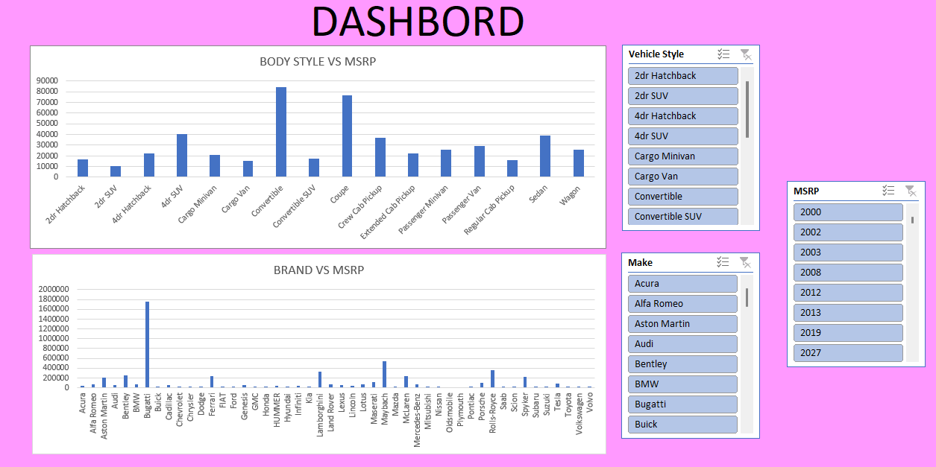

Slide 34
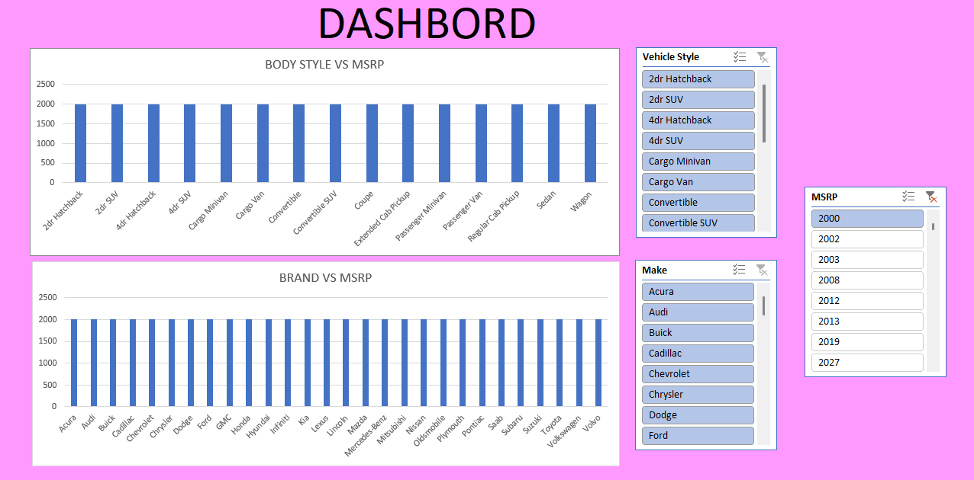

Slide 35
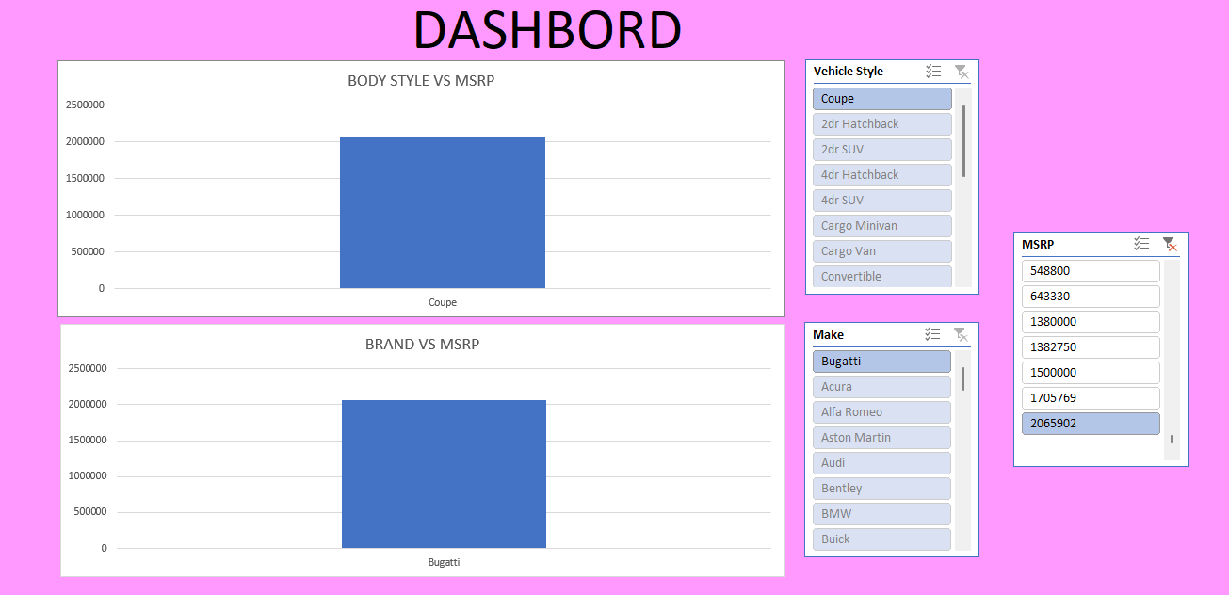
Overall, this interactive dashboard can help users understand the distribution of car prices by brand and body style, and identify the car brands with the highest and lowest average MSRPs for each body style. This can inform pricing and marketing strategies, and help users make data-driven decisions.

Slide 36
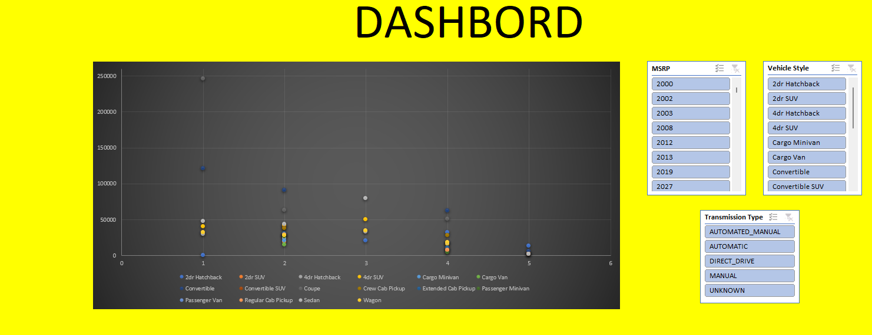
Task 3: How do the different feature such as transmission type affect the MSRP, and how does this vary by body style? Hints: Scatter plot chart to visualize the relationship between MSRP and transmission type, with different symbols for each body style. Calculate the average MSRP for each combination of transmission type and body style using AVERAGEIFS or Pivot Tables.
This chart will allow us to visually see how the MSRP varies by transmission type and body style, as well as identify any trends or patterns in the data.

Slide 37
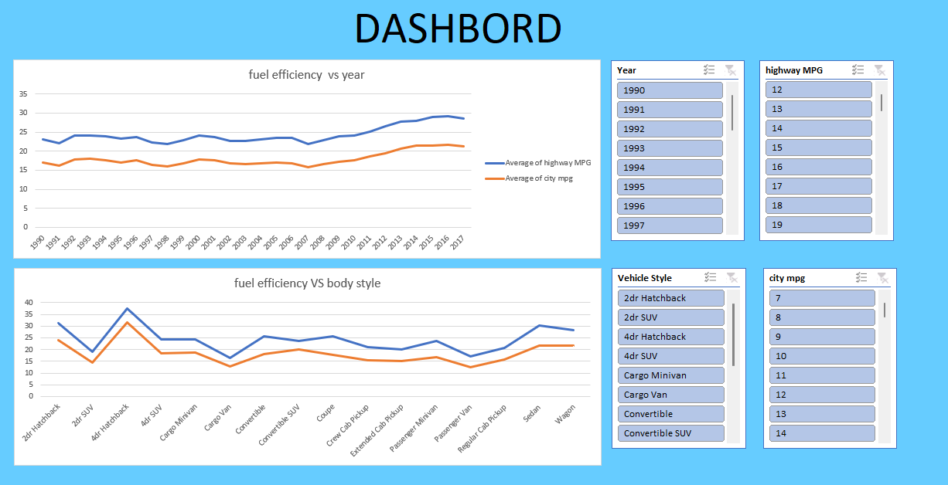
Task 4: How does the fuel efficiency of cars vary across different body styles and model years? Hints: Line chart to show the trend of fuel efficiency (MPG) over time for each body style. Calculate the average MPG for each combination of body style and model year using AVERAGEIFS or Pivot Tables.
In this dashboard, the line chart shows the trend of fuel efficiency over time for each body style. The user can use the slicers to filter the data by body style and model year. The chart and slicers are formatted to be visually appealing and easy to use. Additional context and explanations can be
added as needed to provide more
information about the data being
displayed.
Was this response better or worse?

Slide 38
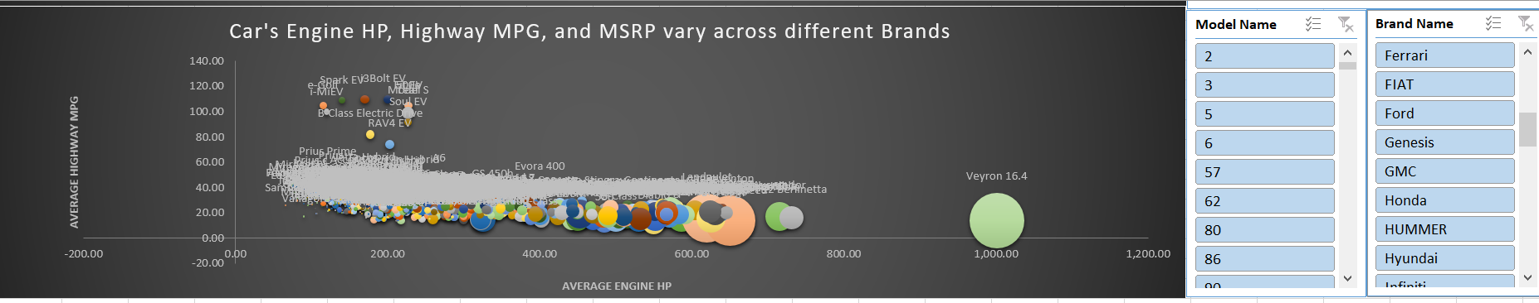
Task 5: How does the car's horsepower, MPG, and price vary across different Brands? Hints: Bubble chart to visualize the relationship between horsepower, MPG, and price across different car brands. Assign different colors to each brand and label the bubbles with the car model name. Calculate the average horsepower, MPG, and MSRP for each car brand using AVERAGEIFS or Pivot Tables.
Overall, this analysis suggests that car buyers must prioritize their preferences between performance and fuel efficiency when selecting a brand and model, as there can be significant trade-offs between these two features.

Slide 39
RESULT
Based on the analyses conducted, here are the key insights:
Car brands have a significant impact on the average MSRP, with luxury brands having higher average MSRPs compared to non-luxury brands.
The body style also affects the average MSRP, with SUVs having higher average MSRPs compared to sedans and hatchbacks.
The fuel efficiency of cars has improved over the years, with SUVs showing the most significant improvement in MPG.
There is a positive correlation between a car's engine power and its price.
The average horsepower, MPG, and MSRP vary significantly across different car brands, with luxury brands having higher average horsepower and MSRP compared to non-luxury brands, and non-luxury brands having higher average MPG compared to luxury brands.
These insights can be used to inform pricing strategies, marketing campaigns, and product development for car manufacturers and dealerships.
For example, luxury brands can focus on promoting the high horsepower and premium features of their vehicles, while non-luxury brands can emphasize the fuel efficiency and affordability of their cars. Additionally, dealerships can use these insights to optimize their inventory and pricing strategies to maximize profitability.

